Slide 1
The Zen of Coding
Lesson 1.1

Slide 2
The Path of Learning

Slide 3

Your Goals
Basically, 100% of you said new career.
Notes:
shutterstock_520041586

Slide 4
Your Goals
And why do you want a new career?
To pursue a dream
To escape a dead-end job
To be able to create
To follow a fascination
To attain financial stability
To obtain financial freedom
To challenge yourself
To be a role model to kids

Slide 5
Your Goal = Our Goal
As instructors, we take your goals very, very seriously.

Slide 6

Support Team Promise
If you’re willing to put in the time and take our advice, we’re here to help you 100% of the way.
This goes for everyone working on this program:
Instructors
TAs
Student Success Team
Career coaches
Everyone else!
Notes:
shutterstock_137111177

Slide 7
But Remember:
Nothing good comes easily.
Notes:
There are a few things you can do to ensure your success

Slide 8
Our Keys to Success

Slide 9

Don’t Be This Person:
Notes:
Shutterstock_654566557
Those that have the hardest time in the program are not the ones who came in knowing no programming.
It’s not the ones who haven’t played around with HTML, CSS, or Javascript.
It’s the ones who walk in thinking they either A) Know more than they do. Or B) Are experts in a completely different field.
There is something that stops people like this from accepting the reality.

Slide 10

This Should Be You
Notes:
Shutterstock_667830277 Having a humble attitude is the first requirement of being successful in this program.
shutterstock_667830277

Slide 11
Our Mantra for Today and Beyond
When it comes to web development…

Slide 12
I know nothing.
Notes:
Don’t be frustrated! Keep an open mind – you’re here to learn.
You mastery of other subjects, educational backgrounds, and professional successes do not guarantee that you will do well here. The only thing that will guarantee success is hard work, humility, and a relentless desire to be better.

Slide 13
You.
Notes:
You are a blank slate. Seriously. Don’t lose sight of this image. At first it may feel intimidating. Knowing how little you know. But relish the opportunity and take the privileges it comes with.
You have permission to struggle. To fail. To not “get” everything immediately.

Slide 14
The Path of Learning

Slide 15
Nothing comes easy.
As students, you face three
HUGE obstacles.
Notes:
… there are a few obstacles in the way.
Things that will frustrate you…

Slide 16

Obstacle #1: The Great Confusion
My code doesn't work and I don't know why.
My code works and I don't know why.
Notes:
Shutterstock_1188695488
Obstacle 1 First, learning to code is tough, intimidating, and frustrating at times. You should forget about your uncle/brother-in-law/friend/step-sister who told you about so-and-so learning to build apps in 1 week. Coding is hard. It will take time. There is no way around that.
It’s confusing, difficult, and there’s a ton to learn. But it’s super rewarding when you _do_ learn why your code broke or is working.
shutterstock_1188695488

Slide 17

Obstacle #2: The Great Doubt
“Maybe I’m just dumb.”
Notes:
Shutterstock_215771662
Obstacle 2
There will be many moments where you will doubt yourself.
shutterstock_215771662
Everyone is on the same page as you. No-one in this classroom is dumb. You all have varying backgrounds with differing experiences and exposure.
Everyone was where you are at some point in their career. Every single developer. Me too.
It takes time but you have what it takes; you were selected for this program because we know you have what it takes.
The first few weeks will be difficult, but everyone will be on a pretty level playing field a few weeks in.

Slide 18

Obstacle #3: The Great Distance
Notes:
Shutterstock_411452953
Obstacle 2 – you have a ton of ground to cover!
There’s a lot to learn, and it can be intimidating. But honestly, 6 months will be over before you know it.
shutterstock_411452953
Because of the length of the program, personal issues WILL come up during the course of the program, and it will be challenging to stay motivated.
You should see each other as a family embarking on a long journey. You will become far closer to your peers than you realize. Intensity is no substitute for endurance.

Slide 19

Nothing Comes Easy
Learning to code requires two things:
Persisting in the face of something that feels incredibly hard and confusing.
Maintaining the self-confidence necessary to believe that YOU CAN DO THIS.
Notes:
And will take a while to master. Persisting in general is the #1 hardest thing in this course.
Perhaps tied with having self-confidence (talk about imposter syndrome).

Slide 20

Learning Can Be Frustrating
You can’t tell whether you’re learning something when you’re learning it—in fact, learning feels a lot more like frustration.
What I’ve learned is that during this period of frustration is actually when people improve the most, and their improvements are usually obvious to an outsider. If you feel frustrated while trying to understand new concepts, try to remember that it might not feel like it, but you’re probably rapidly expanding your knowledge.
—Jeff Dickey, author of Write Modern Web Apps with the MEAN Stack: Mongo, Express, AngularJS, and Node.JS (Peachpit Press, 2014)
Notes:
Frustration = learning, seriously. Here’s the author of a pretty famous book on the mean stack:
So how do we get through this frustration and actually learn?

Slide 21
Advice for the Journey
Throughout this course, always remember to:
03
Trust yourself
Work hard!
01
02
Appreciate your successes

Slide 22
Advice for the Journey
Throughout this course, always remember to:
03
Trust yourself
Work hard!
01
02
Celebrate your successes

Slide 23
Advice for the Journey
Throughout this course, always remember to:
03
Trust yourself
Work hard!
01
02
Celebrate your successes
Notes:
Questions?

Slide 24
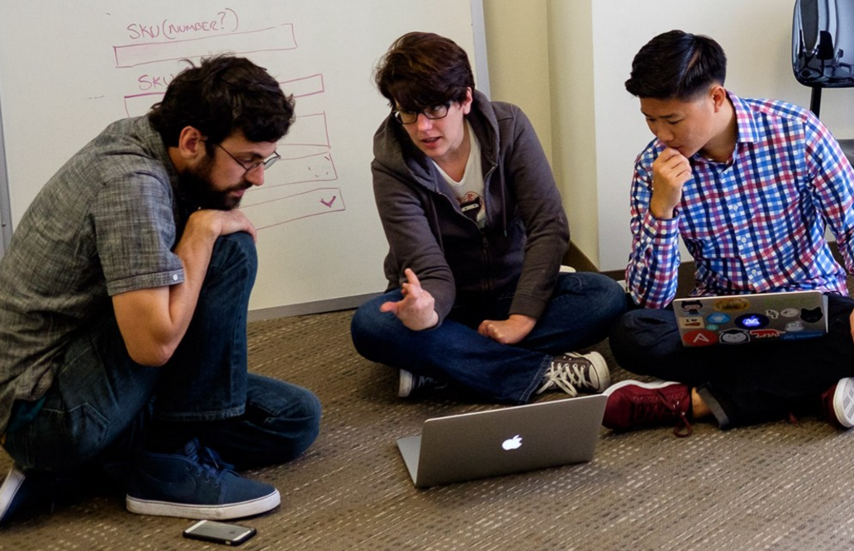
And Remember...
If you want to go fast, go alone. If you want to go far, go with a team.
Notes:
This is a Trilogy image of students and does not violate copyright laws.

Slide 25

Google Fu: The Most Important Skill of All
What Is Google Fu?
Notes:
Of course, to do this, you’ll need to be great at googling!
This is arguably the best/most important skill you can use.
It’s silly, but being able to find the answers to your questions is extremely important, and people won’t always be around. Google should almost always be your first go-to (it has almost every answer, if you know how to find it).
shutterstock_653127499

Slide 26
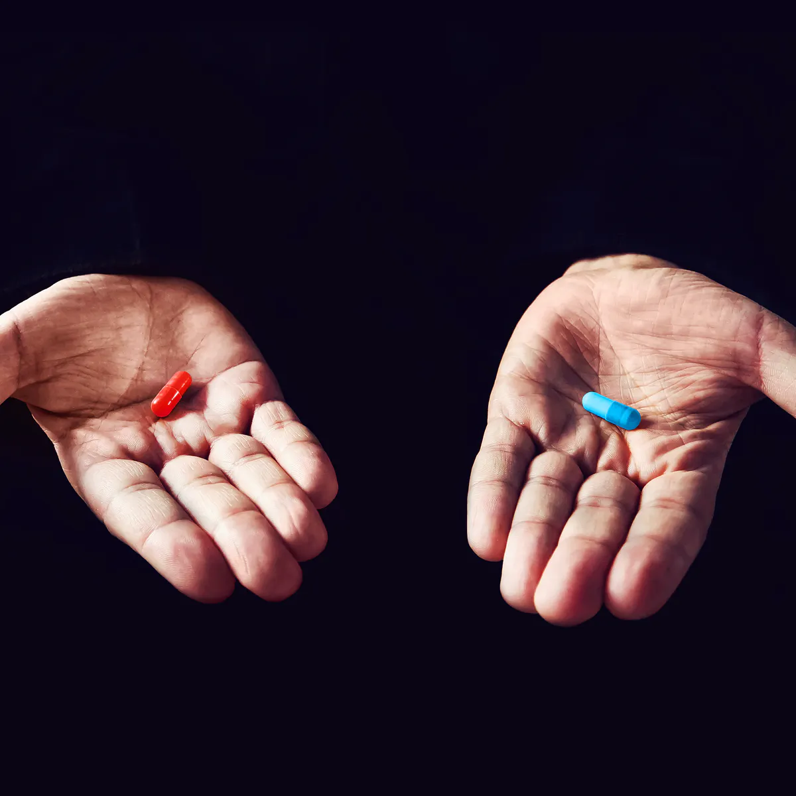
We’re in a unique moment in the job market
We live in a period where specialization is necessary and highly valued. By being in this course, you’re deciding to gain specialize knowledge. It’s painful to gain this knowledge, and that’s part of the reason why many will not. At the same time, the knowledge is there to be had. There is a vast ocean of learning materials and experiences awaiting you online and in person (including this course). You can apprentice with the world’s best from the comfort of home.
In other words, specialization is a struggle, but more than ever before there is more opportunity for all to do so.
Vast struggle and great reward
Continue with the old routine and accept whatever may come
Notes:
Of course, to do this, you’ll need to be great at googling!
This is arguably the best/most important skill you can use.
It’s silly, but being able to find the answers to your questions is extremely important, and people won’t always be around. Google should almost always be your first go-to (it has almost every answer, if you know how to find it).
shutterstock_653127499

Slide 27
Course Structure
Notes:
Now that we’ve talked about the journey and how to be successful, let’s talk about the stops along the way.

Slide 28

Daily Schedule
In each class, we’ll cover the following:
Set objectives
Brief background lecture
Watch me/coding demos
Code discussions
In-class exercises
This is the super important stuff—ALWAYS BE CODING!
Project work
Notes:
By coding! Unfortunate, right?
We’ll get a ton of in-class practice reading and writing code, so the course quickly becomes “code-centric”.
Most days will be much less presentation-heavy than today.
Questions?

Slide 29
Prework
Notes:
So next up I want to spend a little bit of time checking that everyone has everything they need installed (from the pre-work).
If you can check off all of these things, spend this time helping your neighbors. This should become a habit – try to ask for help form your neighbors before going to a TA (you will both learn more along the way). < We’ll talk more about this soon.
That said, let’s check some things off of a list.

Slide 30
Software Checklist
At this point, you should have all of these installed:
Slack
Visual Studio Code
Git
Git Bash (Windows) or Terminal (Mac)
Google Chrome

Slide 31
Accounts Checklist
You should also have accounts for:
GitHub (with SSH Integration)
LinkedIn
Stack Overflow

Slide 32
Self-Check
Let’s do some quick checks of the following:
Visual Studio Code Check
Git Bash/Terminal Check
Git Check

Slide 33
BREAK - 15 minutes

Slide 34
The Modern Web

Slide 35
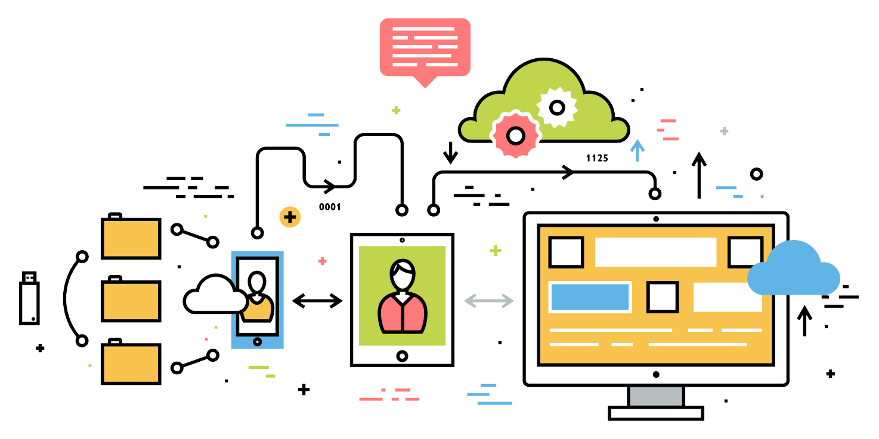
What Exactly Is Full-Stack Development?
Notes:
So what exactly does it mean to be a “full stack developer?”

Slide 36

The “Magic” of YouTube
Notes:
Let’s use YouTube as an example. (Go to YouTube and do basic search)
You’ll learn all of this in time, but a basic YouTube search requires two things:
A ”frontend” – the graphical user interface which responds to what I type
A “backend” – the code on the “server side” that is able to do the logic behind the search, find the relevant videos, and send them along
(Go to next slide)
shutterstock_1024261021

Slide 37




Full-Stack Development
FSF FLOW
In modern web apps, there’s a constant back-and-forth communication between two key components: the visuals displayed in the user’s browser (front end) and the data and logic stored on the server (back end).
Browser shows webpage to user
Web browser
Front end
User requests a webpage
Browser talks to server
Server sends HTML back to browser
MySQL database
Server queries database
Server
Back end
Database returns query results
Server passes data to template engine
Template engine renders HTML
Template engine
Notes:
Websites today are all about reading code for these components – “front-end” and “back-end”

Slide 38
Full-Stack Development
FSF FLOW
Full-stack development is the concept of building every aspect of the web application— from the visuals and interactions to the data transfer and processing.
Browser shows web page to the user
Web browser
Frontend
User requests a web page
Browser talks to server
Server sends HTML back to browser
MySQL Database
Server queries database
Server
Backend
Database returns query results
Server passes data to template engine
Template engine renders HTML
Template engine
Notes:
That is “Full-Stack Development” – you can and will build the whole thing.

Slide 39
Full-Stack Development
The Browser | Dev Tools | Server Side
HTML | Heroku | Templating engines
CSS | Git | Sessions
JavaScript | GitHub | Writing tests
jQuery | Databases | Node.js
Bootstrap | MySQL | Express.js
SEO | MongoDB | Creating APIs
API Interaction |  | MVC
APIs (Consuming) |  | User authentication
JSON |  | ORM (Object-relational mapping)
AJAX |  | CS Fundamentals
Cutting-Edge Development |  | Design patterns
Progressive Web Applications
React.js
Notes:
In this course, you’ll learn everything you need to be able to do this –
you’ll be able to build complex web applications even as a single developer.
Questions?

Slide 40
Let’s Get Crackin’!

Slide 41

Intro to Console/Terminal
Notes:
The terminal is the portal to your computer – it allows you to run and even script commands that can create files, folders, and more.
It is extremely important that you get intimately familiar with the terminal as soon as possible, as you’ll use it for almost everything. It is fast and powerful.
NEXT

Slide 42
Let’s Get Crackin’—Intro to Console
Notes:
So let’s run through a couple of examples.

Slide 43
Activity: Console Commands
12 minutes

Slide 44

Activity: Console Commands
Suggested Time: 1 min
Create a folder on your desktop named code. You’ll put all the code you write today inside that folder.
Best Practices:
Always use lowercase for folder and file names.
Never put spaces in folder and file names.
Use dashes to separate words in folder and file names.
Notes:
Your turn!

Slide 45

Activity: Console Commands
Suggested Time: 12 minutes
From the Terminal/console and using only the command line:
BONUS!
Create a new folder with the name first-day-stuff.
Create a new HTML file with the name first-day.html.
Open the current folder containing the new HTML file.
Create multiple directories/folders with the names one-folder and second-folder with one command.
Create multiple files with the names one.html and two.html with one command in the first-day-stuff directory.

Slide 46

Intro to Console: Discuss with Neighbors
Notes:
Re-ask the questions after a couple of minutes walking neighbor-discussion:
How do you create a new folder?
How do you create a new file?
shutterstock_81648802

Slide 47
Hello, HTML
Notes:
Now that you can create HTML files from the terminal, let’s create one and actually write some HTML.

Slide 48
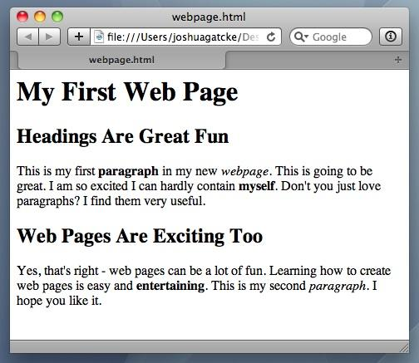
<title>Intro to HTML</title>
HTML5
HTML is one of the three base languages behind every website.
It defines all the basic content and a bit of formatting.

Slide 49
Activity: Intro to HTML
5 minutes

Slide 50
Activity: Intro to HTML
Suggested Time: 5 minutes
In a new HTML file, create the basic structure of an HTML document and include the following in it:
DOCTYPE declaration
Head tag with a title tag
H1 tag with a title of your choice
An embedded image
Now add the following three links to your page:
One link that has target="_blank" so that it opens a new tab when clicked
One link that is bold
One link that is only a placeholder (it goes nowhere)
BONUS!
Create an ordered list of steps to make a sandwich
Create an unordered list of five bands/musicians you like
Create a table with two columns (animal class and animal name) and four rows of animals
Use an alternate way of separating links without line breaks
Embed a YouTube video of your favorite band/musician

Slide 51

YouTube Video Walkthrough
Watch the walkthrough video:

Slide 52

<title>Intro to HTML</title>
How’d it go?

Slide 53
Homework Activity
Notes:
Please note: students are not required to submit this activity. This is just something they should do at home after their first class.

Slide 54
Homework Activity
01
Figure out where the GitLab repo is for our class.
02
Redo the Terminal example from today’s class.
03
Redo the HTML example from today’s class. (Watch the walkthrough video if you feel a bit lost.)
Notes:
Please note: students are not required to submit this activity. This is just something they should do at home after their first class.

